Slide 1



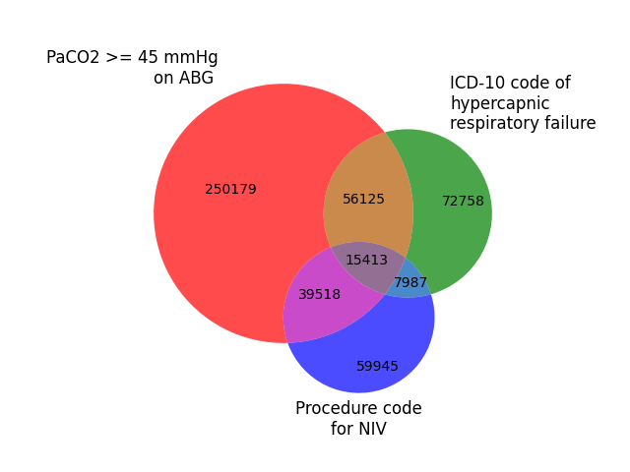
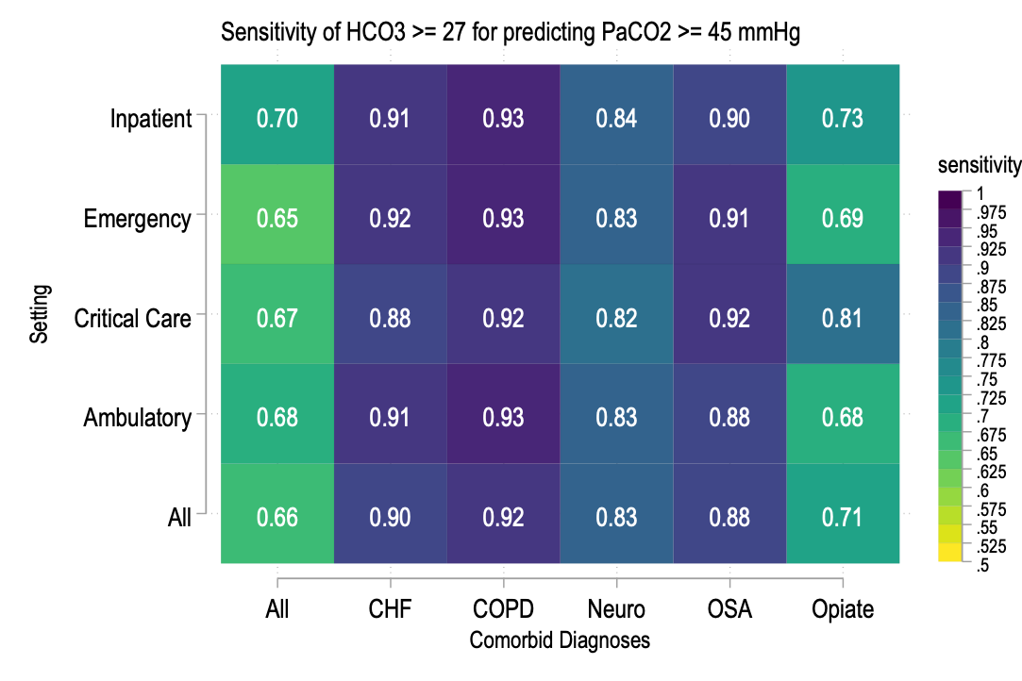
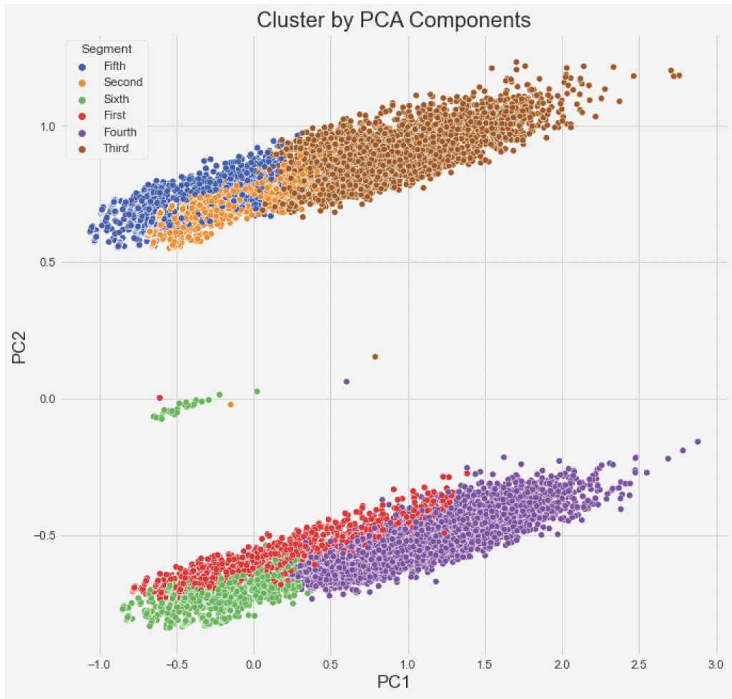
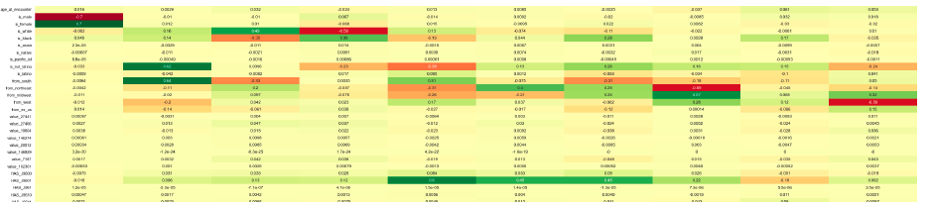
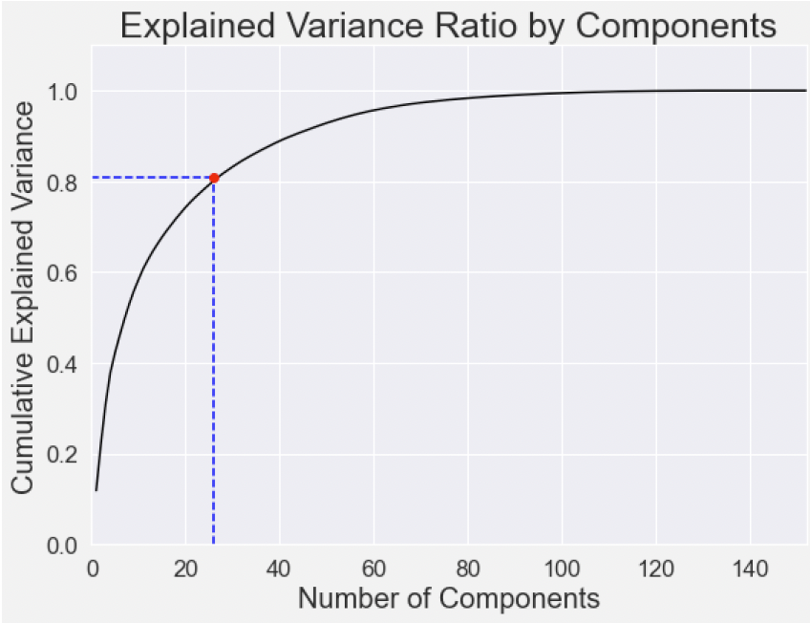
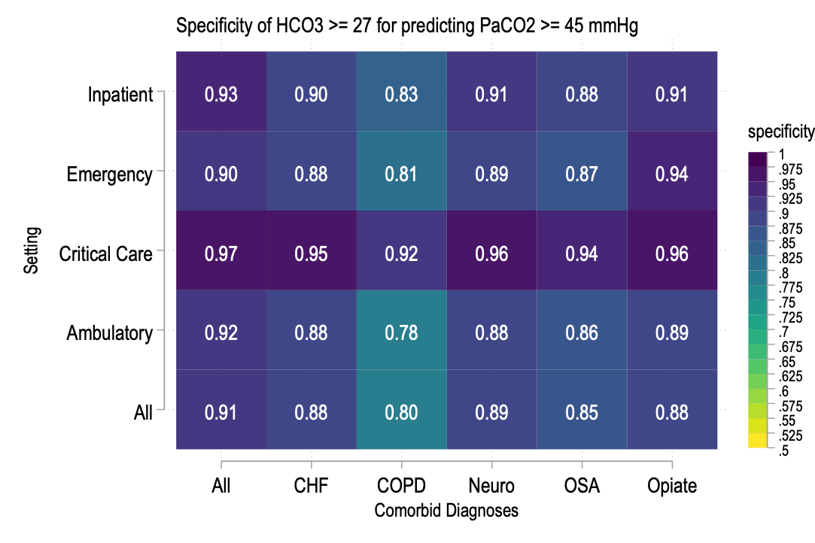
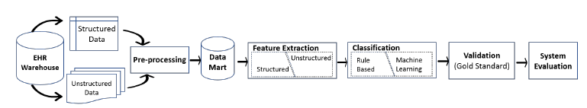
The causes, prevalence, and consequences of hypercapnic respiratory failure are not well described. EHR data could help.
Non-Cognitive Predictors of Student Success: A Predictive Validity Comparison Between Domestic and International Students
PRESENTER:
Brian W Locke, MD
Wayne Richards BS
Jeanette Brown MD PhD
Ram Gouripeddi MBBS MS
Krishna Sundar MD
WHY? The gold-standard test (ABG showing PaCO2 > 45 mmHg) is unreliably obtained.
WHAT HAS BEEN DONE?
Prevalence ~= PE (150 per 100k/y)
Readmission ≥ CHF (23%, 30d)
Mortality ~= Cancer (~40% 1yr)
.
Yet, methods of identification select very different patients.
Ruth L. Kirschstein National Research Service Award 5T32HL105321
METHODS:
925,512 patients
70 Healthcare organizations since 2017.
20 gigabytes of data (billions of data points)
HOW CAN WE BETTER IDENTIFY PATIENTS WITH HYPERCAPNIA?
1. Validate Traditional Data-Points
COMPUTABLE PHENOTYPE: (operational case definition)
- Efficacy trial: homogeneity, severity important
- Epi; QI: sensitivity, representativeness
WHY IS THIS WORTH DOING?
Obesity, Opiates, Multimorbidity ↑
Common component causes? Unknown
Evidence: RCTs only of select subsets
Post-acute management?
Disorganized processes of care
Evidence needed to improve
2. Principal Component Analysis
 | ABG Group | ICD Group | NIV Group
Age | 62±18 | 65±16 | 62±17
% Female | 46% | 51% | 42%
% white | 66% | 71% | 65%
% Black | 18% | 19% | 17%
BMI | 30.4±8.3 | 33.1±10.3 | 29.1±8.2
% with CHF | 37% | 30% | 19%
% with COPD | 31% | 30% | 14%
% Opiate UD | 6% | 3% | 3%
% Sleep Apnea | 23% | 24% | 10%
3. Propose and Evaluate Computable Phenotype(s)
Disorganized processes of care
Alzoubi et al. Electronics 2019 doi:10.3390/electronics8111235

